Slide 1
DevOps: Interpretations from Cisco
Ramya Ravichandar, PhD
Technical Leader, Cisco Systems
Oct 23 2014

Slide 2

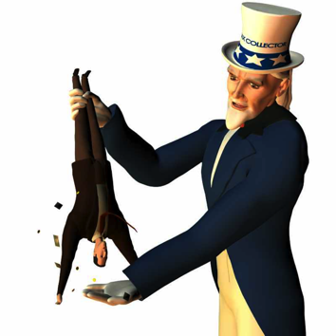
Engineering Operations
Corporate Quality
Learning Organization
Development
Cross Functional Partners
What I do

Slide 3
For over 5 years ..
Last 9 months ..
Agile Transformation
devOps
Lessons Learned
Collaboration Technologies
Wireless Products
Greenfield Initiatives
Platform Teams
Information
Technology

Slide 4
75,049

Slide 5


Slide 6
Majority of teams develop features across multiple sites
% teams
100
80
# sites
60
40
20
Major Cisco Lines of Business

Slide 7
1984

Slide 8
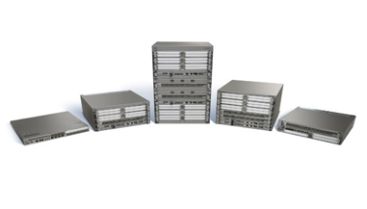
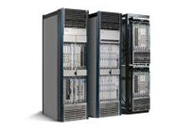
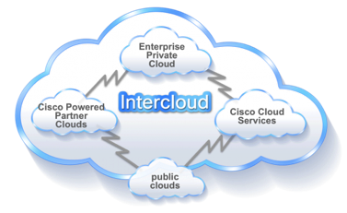
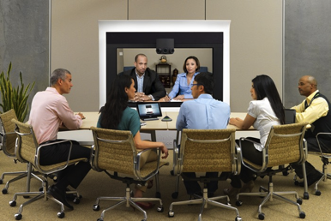
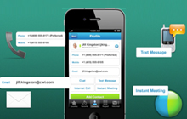

Slide 9
_{Embedded}
_{Application}
_{% of embedded teams}
_{% of application teams}
₁₀₀
₁₀₀
₅₀
₅₀
₀
₀
_{C}
_{C++}
_{Java}
_{Python}
_{TCL}
_{Javascript}
_{HTML5}
_{Assembly}
_{C#}
_{Flash}
_{VHDL}
_{Bash}
_{CSS}
_{HTML / CSS}
_{Microcode}
_{Pearl}
_{Java}
_{C++}
_{C}
_{Python}
_{Javascript}
_{TCL}
_{HTML / CSS}
_{HTML5}
_{C#}
_{Objective-C}
_{CSS}
_{Assembly}
_{Erlang}
_{AutoIT}
_{Pearl}
_{Perl}
_{QT}
_{Scala}
_{Shell}
_{VHDL}
_{Infrastructure}
_{Cloud}
_{% of infrastructure teams}
_{% of cloud teams}
₁₀₀
₁₀₀
₅₀
₅₀
₀
₀
_{C++}
_{Java}
_{Python}
_{C}
_{Javascript}
_{Erlang}
_{HTML / CSS}
_{TCL}
_{Bash}
_{C#}
_{CSS}
_{HTML5}
_{Microcode}
_{Mongo}
_{Objective-C}
_{Pearl}
_{SQL / PL}
_{VHDL}
_{Java}
_{C++}
_{Python}
_{Javascript}
_{C}
_{HTML / CSS}
_{C#}
_{CSS}
_{HTML5}
_{SQL / PL}
_{Flash}
_{Mongo}
_{Pearl}
_{Perl}
_{Scala}
_{Shell}
Source: Baselining survey (Dec 2013-Jan 2014)
Notes:
Large variety of languages across software types may inhibit consistently strong tools support

Slide 10

Source Code Management
Agile Lifecycle Management
Test Automation
Testing & QA
Commit Processing
Development Environments
Build & CI
Defect Management

Slide 11
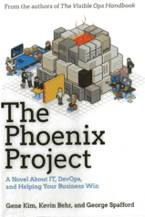
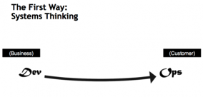
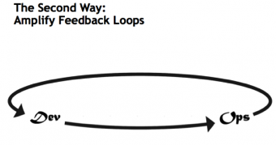
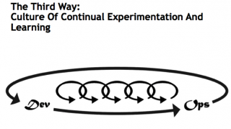
DevOps Principles

Slide 12
First Way- Systems Thinking
“If you put a good person against a bad system, the system wins every time.” – Geary Rummler

Slide 13

DevOps ! = Continuous Delivery
Product Management
Solutions Architect
Upstream Activities
developers
Network engineers
testers
Downstream Activities
Services
Support
Sales
Supply chain/ manufacturing
Notes:
----- Meeting Notes (10/20/14 10:44) -----
supplychain manufaturing

Slide 14

Transformation from the top
Transform the development process at Cisco to enable high performance teams
to build high-quality products
Unleashing Engineering’s full potential
Process
Tools
Teams
Notes:
To achieve this our EVP has kicked off a transformation from the very top.
The goal of dEV is to improve the performance of the development organization
a. Build higher-quality products with shorter innovation cycles, resulting in higher value to the customer – and increase engineers' motivation and productivity
b. Two-fold approach: Transform to agile AND remove obstacles in our environment (e.g. tools) ~ devOps
Process –
Transform to high performance fit-for-purpose dev processes, e.g.
Agile
Continuous integration
Test Driven Development
Teams –
Improve quality and efficiency through re-evaluating
Development and test team structure
Roles
Interactions
Tools –
Simplify and modernize tools to improve the individual Engineer's efficiency
"fire and forget" solutions
Automation
Back to the whole tool chain discussion we had earlier

Slide 15
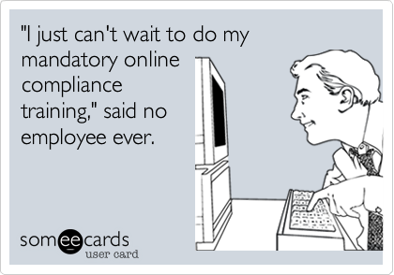
Process & Policies
Notes:
----- Meeting Notes (10/20/14 10:44) -----
chnage picture; new guidelines for asset protection based on provider

Slide 16
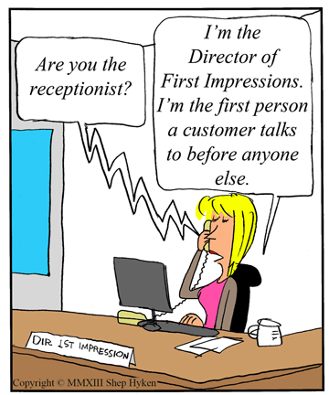
Human
Resources

Slide 17
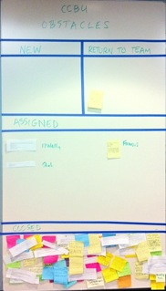
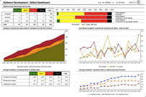

Case Study Example-Cisco Unified Contact Center Enterprise
Management Focus
Quality Ownership
Customer Feedback

Slide 18
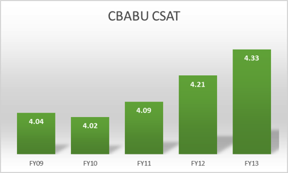
Results …
Cisco is named a 2014 leader in
contact center infrastructure, worldwide.
– Gartner Report
Notes:
----- Meeting Notes (10/20/14 10:44) -----
remove CBABU

Slide 19
Second Way- Amplify Feedback Loops
Information is not a scarce resource. Attention is.
Herb Simon, 1991

Slide 20
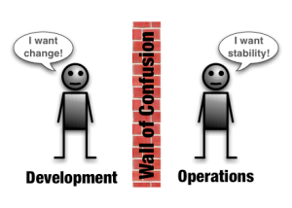
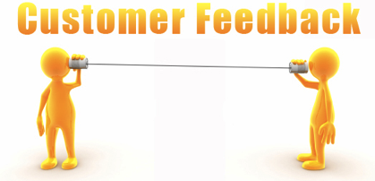
Focus on two feedback loops

Slide 21
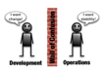



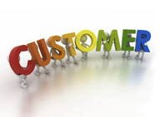


Who is OPs ?
Customer Site test
Product Segment
Cloud
Services

Slide 22






Different Strategies
Customer
Product group
Services

Slide 23



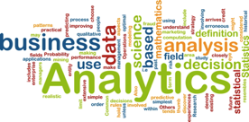

Amplifying Customer feedback

Slide 24
Third Way- Culture of continuous experimentation and learning
“Whenever you solve a problem, you usually create one. You can only hope that the one you created is less critical than the one you eliminated.” – Wiener’s Law

Slide 25
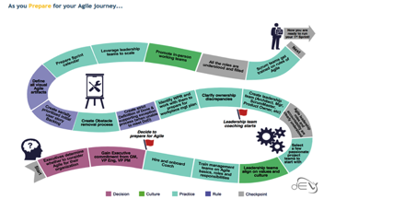
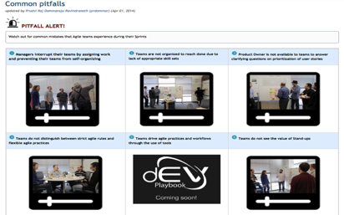
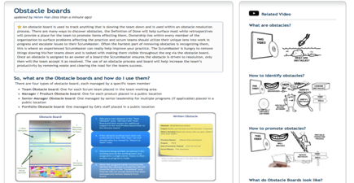
Playbook – Baseline practices at Cisco
Common pitfall videos- featuring Brad Pitfall
Transformation journey illustrates key activities – Prepare, Get Started, and Optimize
Pages containing best practices, actionable checklists, practical tips, Cisco examples & videos
Notes:
----- Meeting Notes (10/20/14 10:44) -----
TAKE out 100 pages - replace

Slide 26
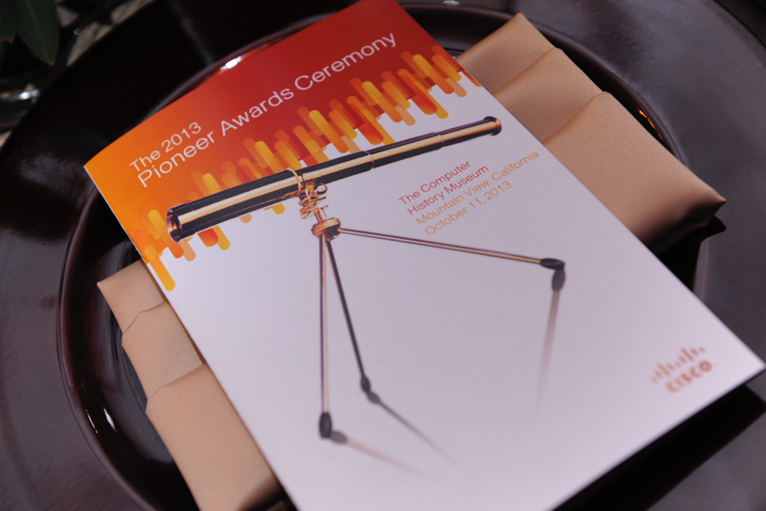

Slide 27
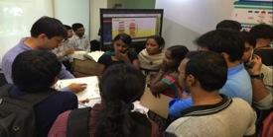
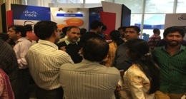
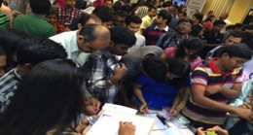
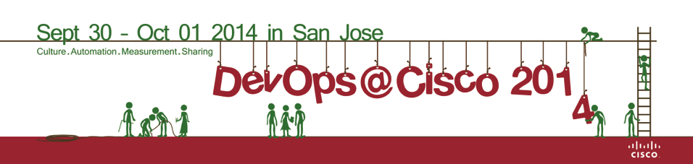
Building Communities
Booth packed with content – tools, experts, videos and apps
And attracted an over 4,000 visitors
EAT corner conducted hands-on sessions with 1,000+ engineers

Slide 28

Help!
Metrics ?
Embedded Systems
Ramya Ravichandar
raravich@cisco.com

